Slide 1
Welcome to Lymm
Lymm UXXs
Team Pic here

Slide 2
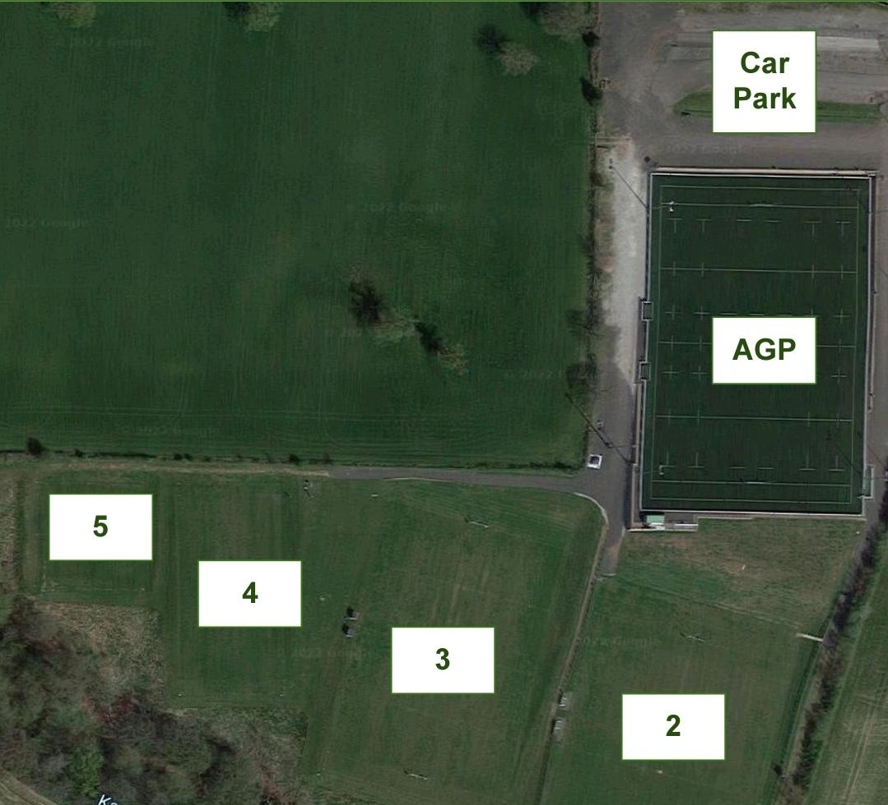
Finding Us
We’re really looking forward to your visit
It’s easy to find us and there’s plenty of parking.
Lymm RFC, Crouchley Lane, Lymm WA13 0AS
01925 753212
www.lymmrugby.co.uk
The Artificial Grass Pitch (AGP) is strictly studs only for players, refs and coaches. No trainers, shoes, wellies or blades please and no food or drink (other than water) allowed on the pitch.
Dogs are welcome on leads but not in clubhouse.
Please bear with us as we’ve got a number or redevelopments and improvements underway.

Slide 3
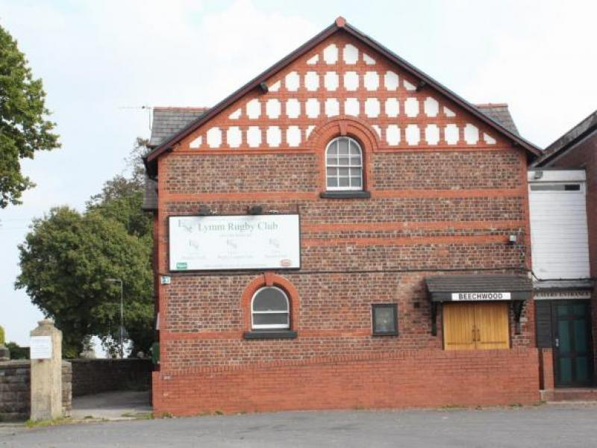
Clubhouse and Facilities
Players, coaches and parents are all welcome in the clubhouse after the game where the bar will be open for drinks and snacks.
Please use your allocated changing room. When minis and juniors are changing, coaches should always go into the rooms accompanied by another (male) adult.
No muddy kit or boots allowed inside the clubhouse.
Players will be served a hot meal and are encouraged to sit down with our lads after the match.
or … Players will be served hotdogs after the game.
Please let us know your numbers by Thursday for catering.
The Halfway House cafe by the AGP will also be open for hot and cold drinks, bacon butties and other snacks.

Slide 4
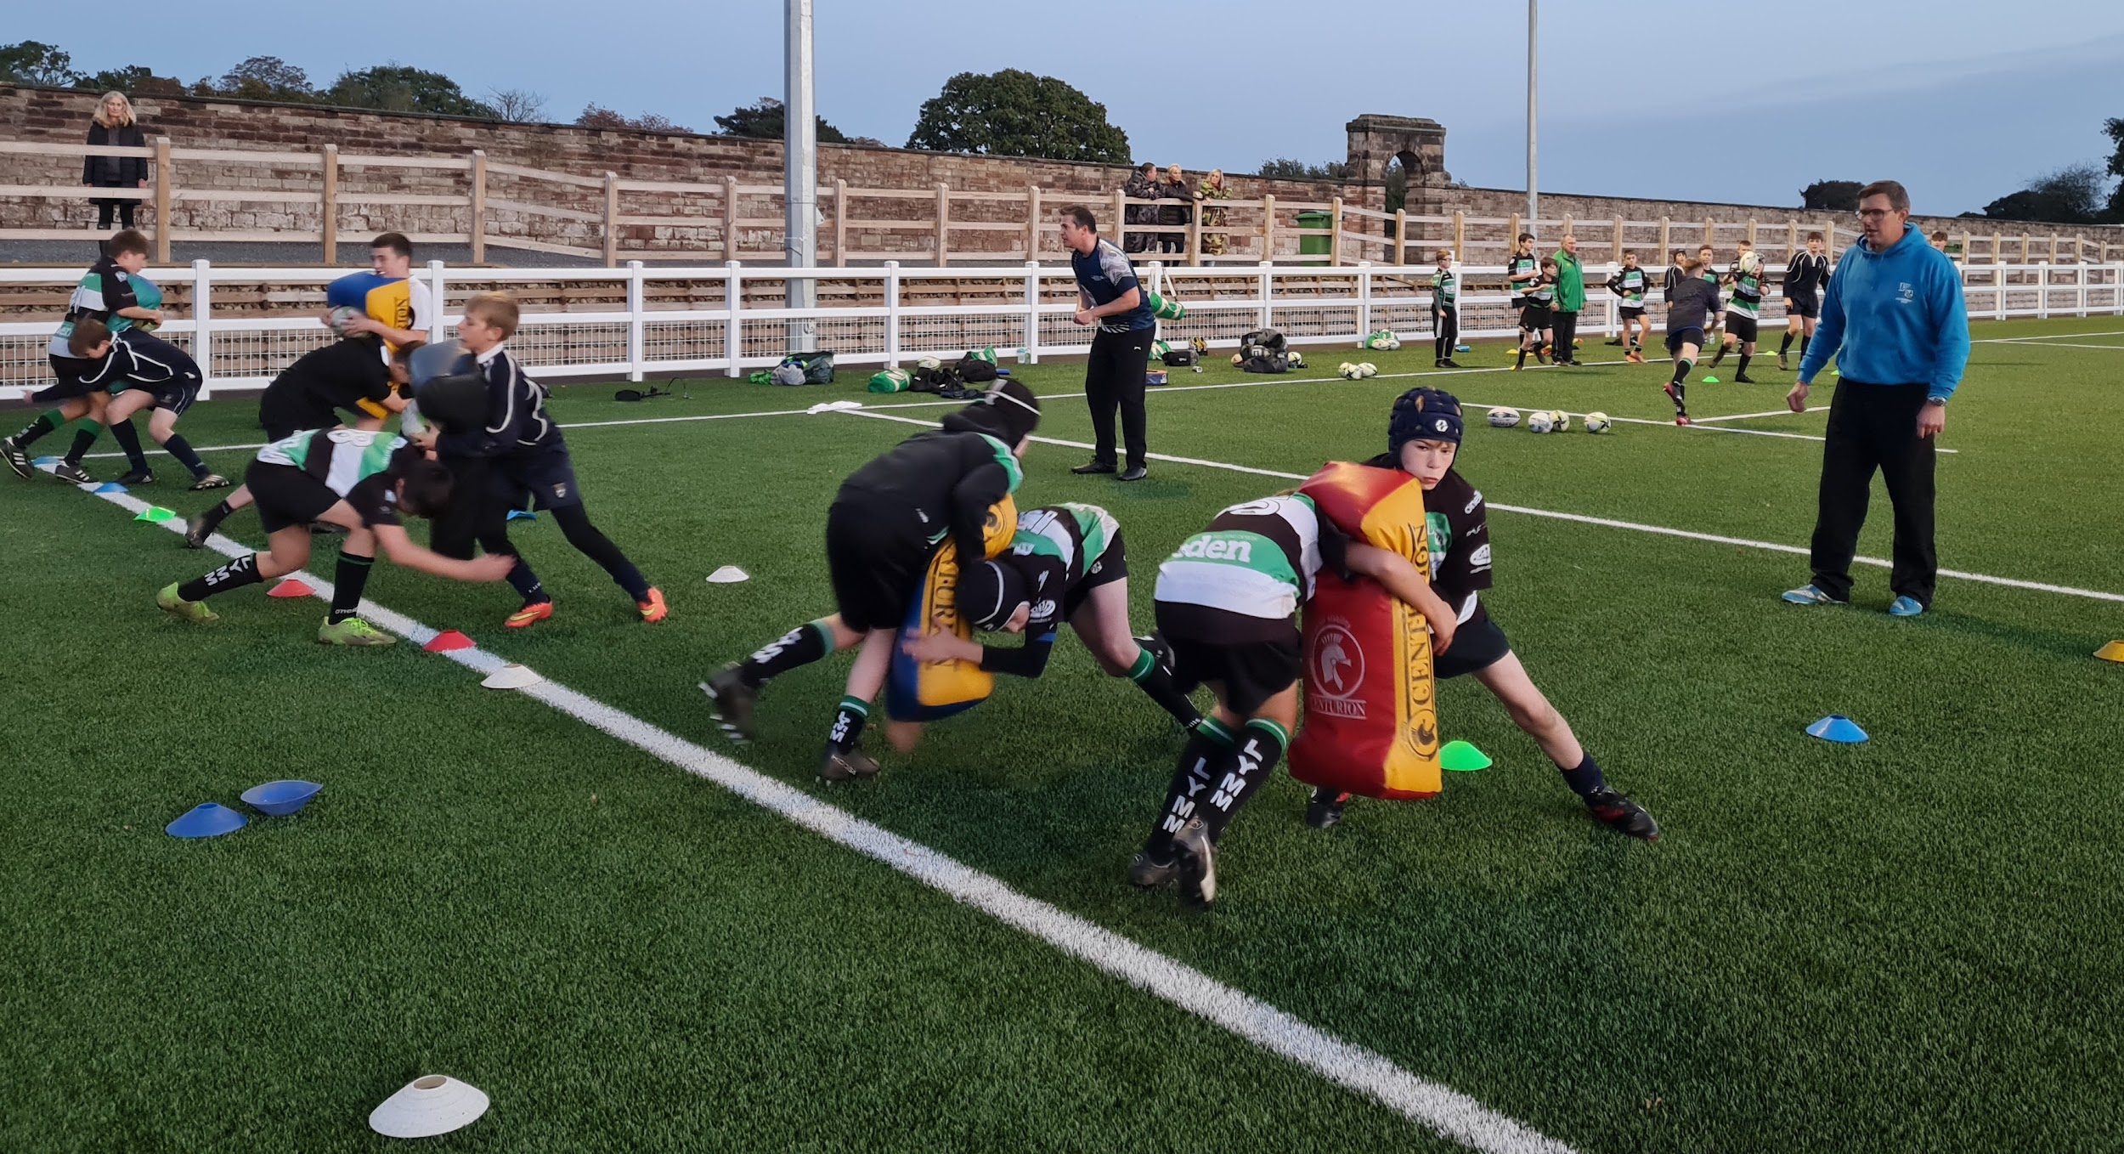
Our Coaches
All our coaches are DBS checked and first aid trained. Most have attended many RFU courses.
Add Coach Names (Head Coach) 07XXXXXXX
Add Names (Team Manager) 07XXXXXXX
Add Names

Slide 5
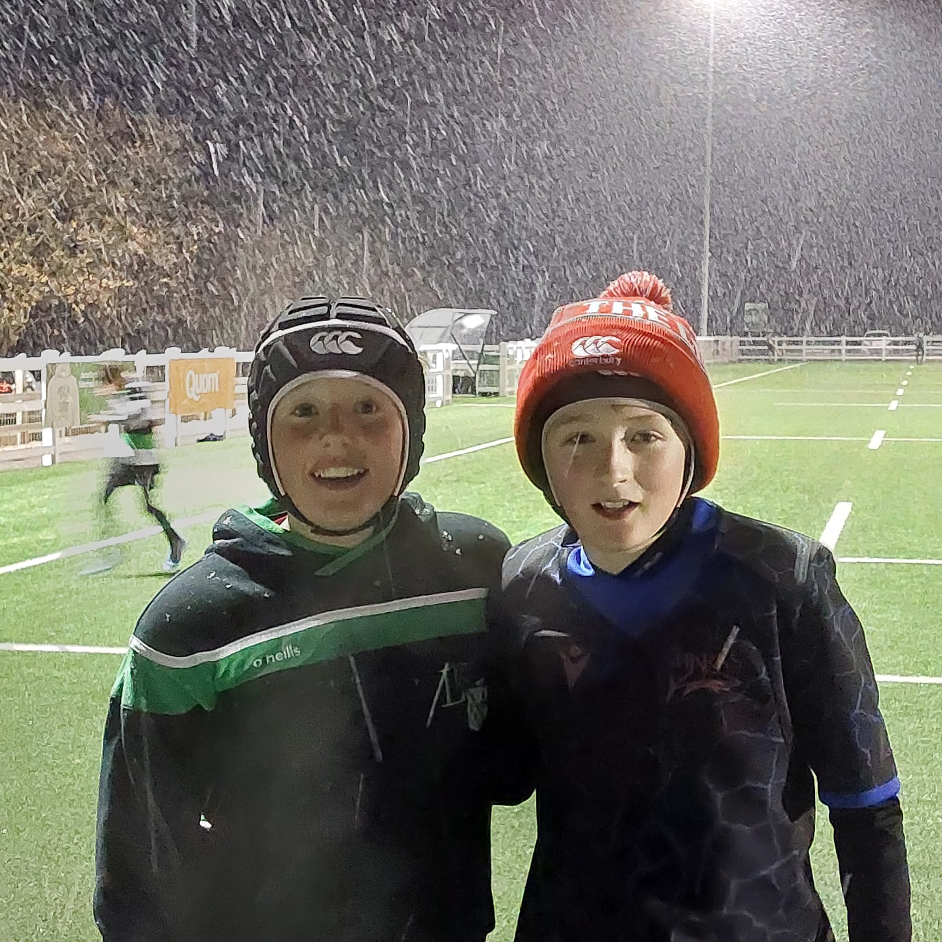
Teamwork - Respect - Enjoyment- Discipline - Sportsmanship
We’re passionate about core values so we look forward to some fun rugby played in the right spirit.
See You Soon!

